Slide 1

Team members:
Social Impact League project
Prototype sprint : Healthcare
Kenji Phang Eleonora Criscione
Javeria Ehsan Maryem Ben Ali

Slide 2

What process did you go through to create your project?
Not experienced with
- Medtech
- Programming/Cloud
Diabetes management apps
Limitations:
limited functionalities
Difficult use of the app’s interface
Notes:
We didn’t really go thrp
We chose to use bots because they are many services that can be integrated to into bots, like Language service, speech service etc, so it kind of acted as milestones for us to learn

Slide 3

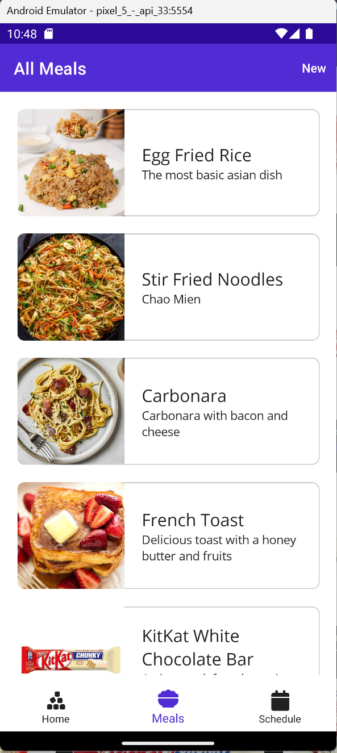
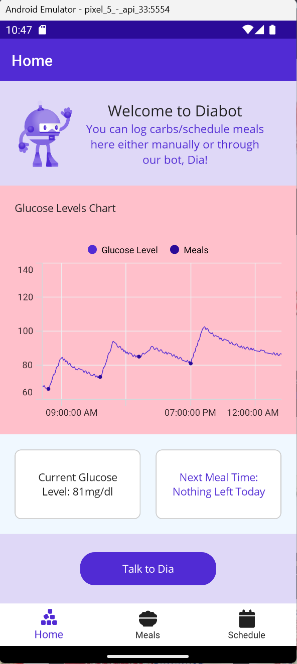
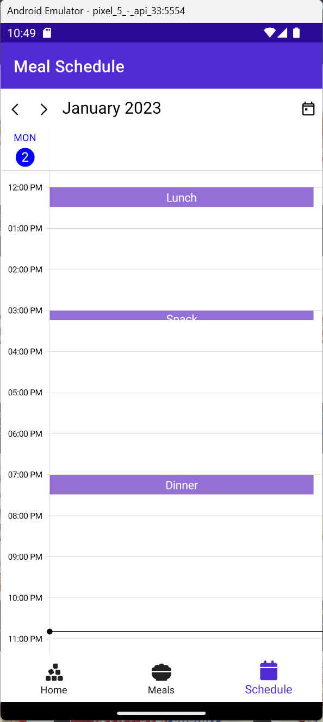
Diabot
Virtual Assistant to manage carb logging for diabetes
Notes:
Our project is Diabot, which is just a name for a diabetes bot, it’s a virtual assistant to help a person manage their carbs and glucose levels, we built it in .net MAUI

Slide 4
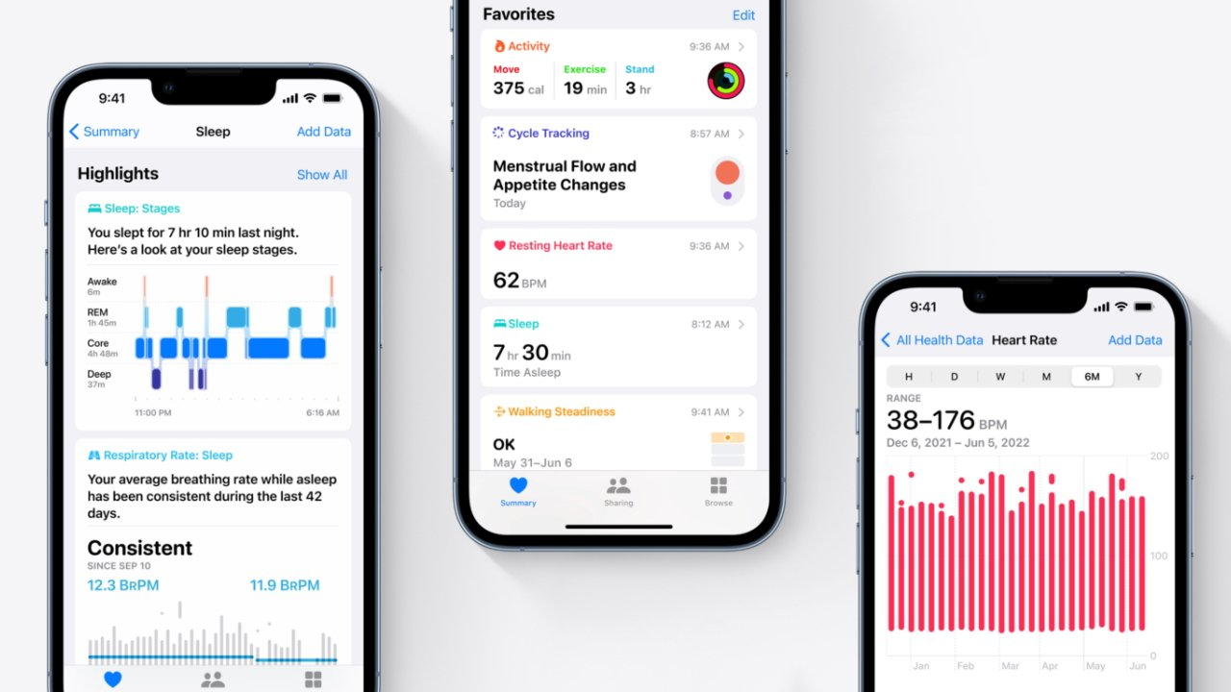


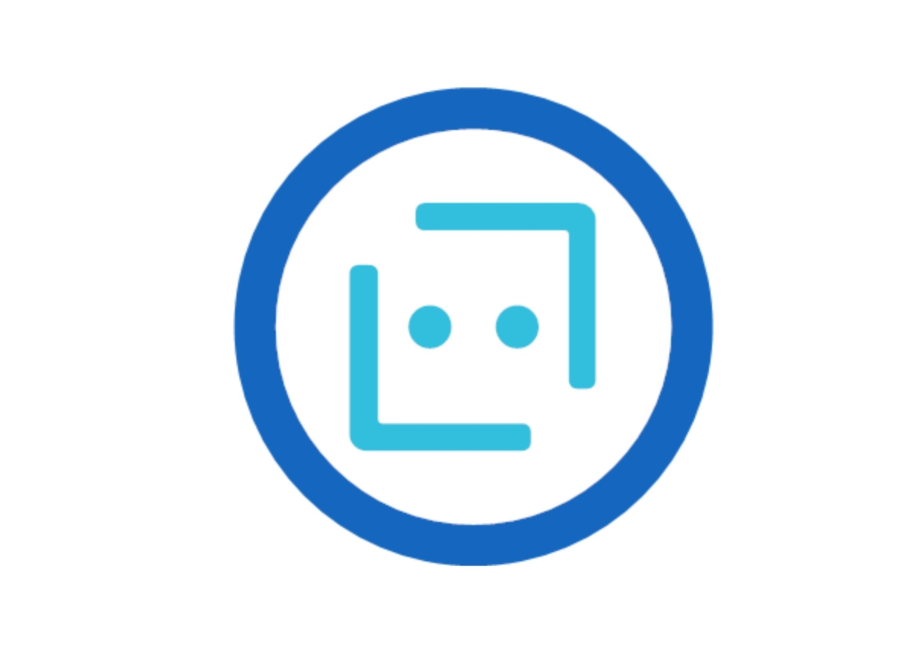
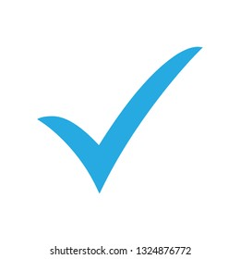

How did you choose what product / service to focus on?
The main goal was to Create “DiaBot”
a chatbot that provides assistance to diabetes
Possible ideas we thought about implementing and Technologies:
make something doable
make a carb/glucose logger app using an intelligent bot interface
Azure ML to fine tune the predicted glucose level the insulin delivery plan
Azure DB to store commonly used recipes for carb planning
Using Azure Bots to interact with the app, summarize charts, add carbs etc
Azure IoT interface towards continuous glucose monitors and insulin pumps

Slide 5
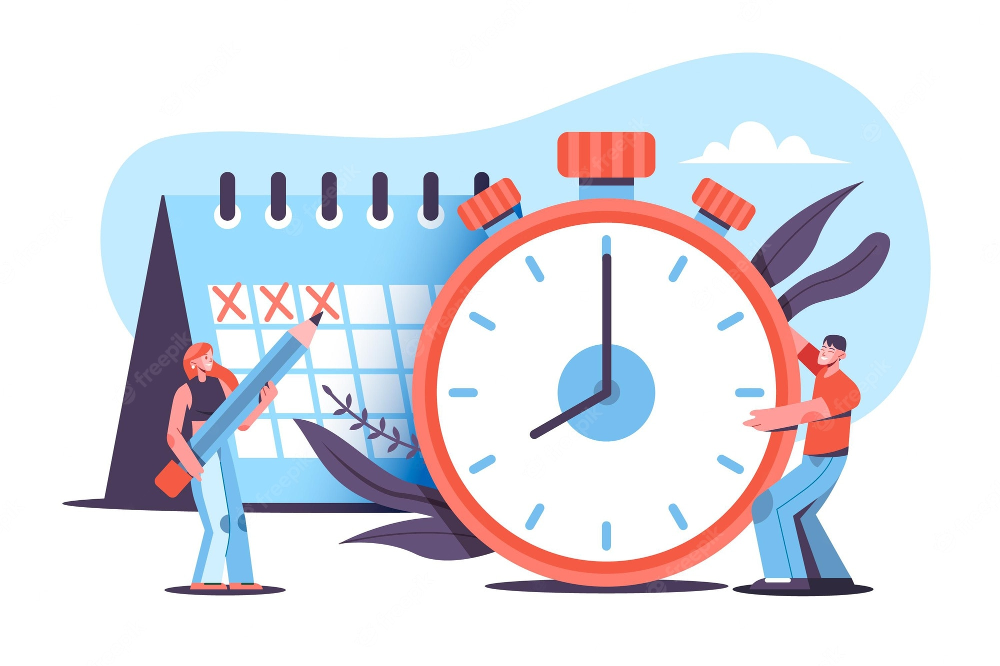
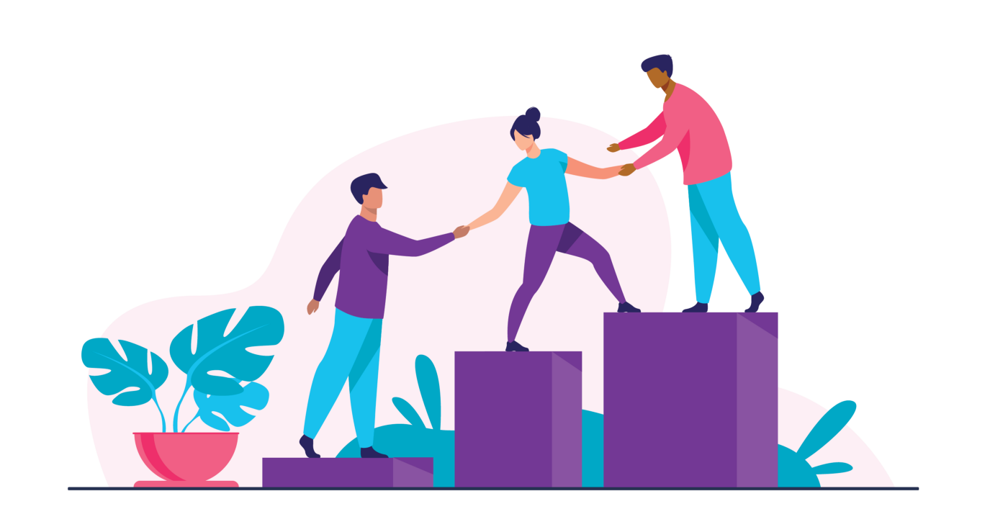
What changes would you make to this process for next time?
Commit time to the project
Look for an experienced mentor

Slide 6


Challenges faced throughout social league project
Settle on an idea
Choosing tech

Slide 7
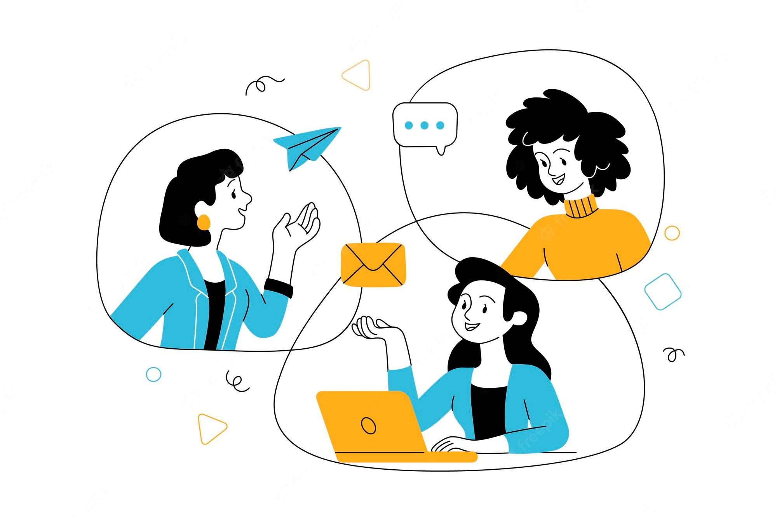
How did you overcome those challenges?
Communication between group
Being open to learning
We asked people in the chat for advice
Notes:
How we overcame these challenges are by …
This is what we recommend to ambassadors doing it the next round as well

Slide 8
The end

Slide 9
Refrences: images: https://jixifox.me/2018/03/09/wonder/wonder-wondering/ https://www.pngitem.com/pimgs/m/319-3194816_disappointed-face-coloring-page-hd-png-download.png https://img.freepik.com/free-vector/hand-drawn-business-communication-concept_52683-76159.jpg?w=2000 http://media.noria.com/sites/Uploads/2019/11/19/3ad0b198-2717-4831-a344-f2e35e943bae_ArticleImages_RP31161_1234x694_08022019_extra_large.jpeg https://img.freepik.com/free-vector/businessman-get-idea_1133-350.jpg?w=2000 https://miro.medium.com/max/1400/0*qQDxuFahBv3CWrdn.png

Slide 10
What process did you go through to create your project? Knowing we have no healthcare studies whatsoever ,we had to do much researches to find the right target we will work on , so what caught our attention is that Diabetes management apps can be a useful tool for diabetes to help them manage their health situation and assist them throughout the process of cohabiting with it, But , these apps may have their limitations such as Limited functionality,Difficult use of the app’s interface
How did you choose what product / service to focus on?
The main goal was to Create “DiaBot”: a chatbot that provides assistance to diabetes as an improved Diabetes management apps with better features using Azure ML, Azure DB, Azure Bots,Azure Maps,Azure IoT(Using Azure ML to fine tune the predicted glucose level to the person , to fine tune the insulin delivery plan and retrain it periodically with user data, Using Azure DB to store commonly used recipes for carb planning, Using Azure Bots to interact with the app, summarize charts, add carbs etc, Adding an Azure IoT interface towards continuous glucose monitors and insulin pumps)
and as implementation phase started,We wanted something that was doable with our experience and we tried out different ideas and so far we managed to make a carb logger app but with a twist, which is to do it using an intelligent bot interface
What changes would you make to this process for next time?
Choose the idea from an early date
it would be useful to have an experienced mentor, maybe engage a supervisor who is more in the field ( and not just a student)

Slide 11
Challenges faced throughout social league project
Settle on an idea that is useful , can be implemented and appeals to all group members
Choosing tech tools with time and skill limit factors: meaning chosing tools that can provide us the feature expected as an output and can be learnt without exceeding time limits
How did you overcome those challenges?
Communication between group members , being open to other’s ideas and ready for any sudden change at any minute if plan A go wrong
Being patient and open to work , committed to the project
We asked people in the chat for advice
Recommendations you have for future teams of ambassadors working on projects
Communication and coordination is the key to success of this project
Always do researches and debates before settling down for a decision in group because sudden failures of plan A can be disturbing sometimes , it s better to think more in order to reduce the rate of its failure
It’s better to have an idea about how to use the tech tools you will be using or else you will be lost in the process

